Slide 1

Bitcoin Price Prediction Project
Forecasting • Machine Learning • Power BI Dashboard
Created by :- Pavan Lade (BIA)

Slide 2
Project Overview
Project Benefits
• Objective: Predict Bitcoin closing prices using forecasting and ML models.
• Designed to support trading strategies and investment planning.
• Includes forecasting models, insights, and a Power BI visualization layer.
• Improved decision-making through accurate BTC trend prediction.
• Enhanced risk management using volatility and price forecasting.
• Better trading strategies driven by analytics and model outputs.
• Visual dashboard providing real-time insights.

Slide 3
Data Exploration Summary (BTC-USD Time Series)
Dataset Overview
Total observations: 3566 trading days
Features include: Open, High, Low, Close, Adj Close, Volume, Daily Return
Represents long-term historical price and volume movements of Bitcoin (BTC) in USD
📈 Price Statistics
Central Tendencies
Average Open Price: 17,130.77
Average Close Price: 17,146.36
Price distribution shows wide variability, indicating BTC’s historically volatile nature.
Median Values
Median Open: 8,940.44
Median Close: 8,987.82
Median values significantly lower than means → suggests right-skewed distribution with large price spikes in later years.

Slide 4
📉 Price Range & Volatility
Price Range
Minimum Close: 178.10
Maximum Close: 73,083.50
Extreme range reflects BTC’s exponential growth over time.
Standard Deviation
Price standard deviation ≈ 18,900, showing very high volatility.
📊 Volume Analysis
Average trading volume: 17.46 billion
Volume ranges from ~5.9M to 350B
High variability indicates shifting market involvement across years.
📈 Daily Returns
Mean Daily Return: 0.21%
Standard Deviation: 3.65% — confirms large day-to-day movement.
Maximum Daily Return: +25.25%
Minimum Daily Return: –37.17% → Highlights Bitcoin’s susceptibility to sudden large swings.

Slide 5
Key Insights
• Bitcoin shows strong upward momentum during bull cycles.
• Significant price changes often follow high-volume spikes.
• MA indicators help identify trend direction.
• Forecast model shows expected short-term movement.
Data Preprocessing (Summary)
Data Loading: Imported BTC-USD dataset with Date, Open, High, Low, Close, Adj Close, and Volume.
Data Cleaning: Checked for missing values — none found.
Date Formatting: Converted Date column to proper datetime format.
Feature Selection: Used key financial features (Open, High, Low, Close, Volume) for analysis.
Outlier Check: Reviewed data trends; no major anomalies requiring removal.
Scaling (if modeling): Applied MinMax/StandardScaler for ML model readiness.
Final Output: A clean, structured, and time-indexed dataset ready for analysis and forecasting.

Slide 6
Feature Engineering (Summary)
Return_1d: Calculated the daily percentage return from the previous day’s closing price. Helps capture short-term price movement and volatility.
MA7 (7-Day Moving Average): Smooths out short-term fluctuations by averaging the last 7 closing prices. Useful for identifying short-term trends.
MA21 (21-Day Moving Average): Captures medium-term market trends by averaging the last 21 days of closing prices. Helps understand broader price direction.
Lag_1: Stores the previous day’s closing price as a predictive input. This helps the model learn from recent price behavior.
Final Step: Removed rows with missing values created by rolling/shift operations and selected the four engineered features for modeling.

Slide 7
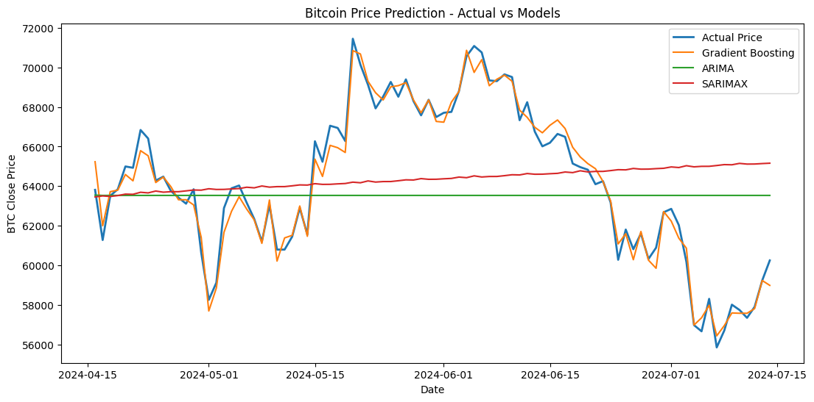
Model Selection
Gradient Boosting (Machine Learning Model)
A tree-based ensemble model trained on engineered features.
Captures non-linear patterns in Bitcoin price movements.
Output: Predicted Close prices on test data.
ARIMA (Classical Time-Series Model)
Models trend + autoregressive patterns in historical Close prices.
Suitable for short-term forecasting in stationary time series.
Used parameters: ARIMA(1,1,1).
SARIMAX (Advanced Seasonal Model)
Extends ARIMA with seasonality and exogenous patterns.
Seasonal parameters used: (1,1,1,7) to capture weekly cycles.
Provides more flexible trend + seasonal forecasting.

Slide 8
Model Performance Summary
Evaluation Metrics
RMSE (Root Mean Squared Error): Measures average prediction error.
R² Score: Indicates how well the model explains variance.
MAPE (%): Average percentage deviation from actual values.
Accuracy (%): Overall prediction correctness.
Type | 1. Gradient Boosting | 2. ARIMA | 3. SARIMAX
RMSE | 573.17 | 3948.21 | 4048.83
R² Score | 0.978 | –0.03 | –0.08
MAPE | 0.69% | 5.10% | 5.23%
Accuracy | 99.30% | 94.90% | 94.76%
Result | ✔ Best overall performance ✔ Most accurate and stable model | ✖ Higher error, weak model fit | ✖ Highest error, poorest performance

Slide 9
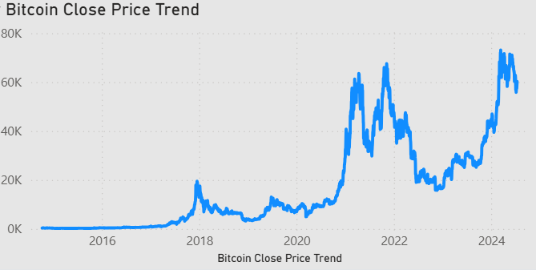
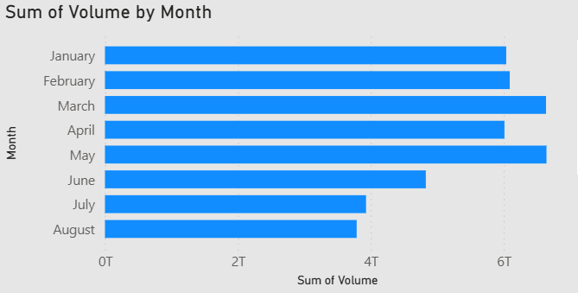
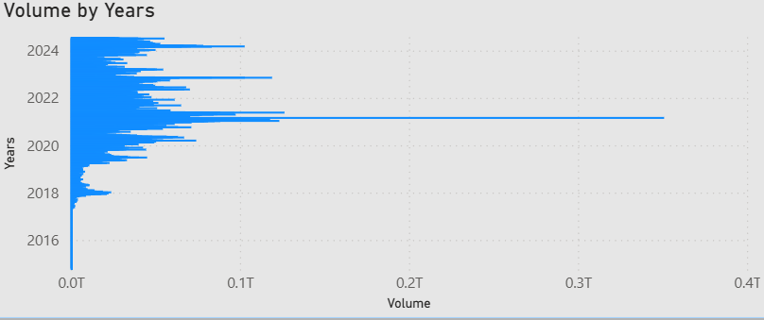
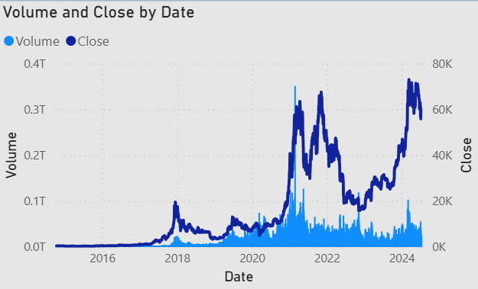
Power BI Dashboard Overview

Slide 10
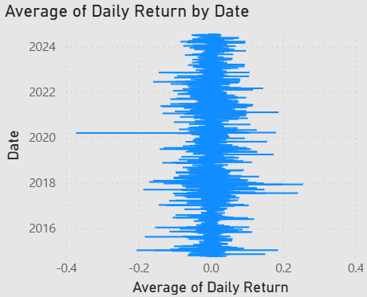
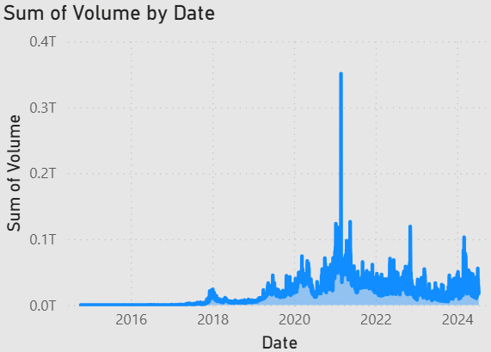
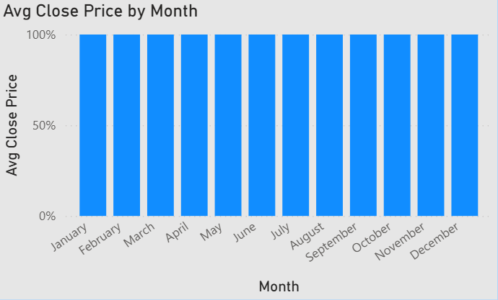
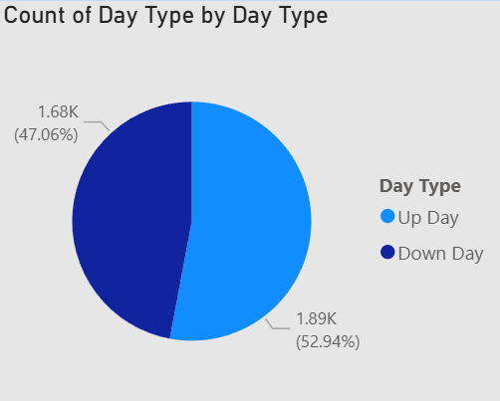

Slide 11
Conclusion
The project successfully analysed and predicted Bitcoin prices using machine learning and time-series models.
Comprehensive preprocessing, feature engineering, and exploratory analysis helped build a reliable forecasting pipeline
Among all models tested, Gradient Boosting delivered the best performance, achieving:
Lowest RMSE
Highest R² Score
Lowest MAPE
Highest Accuracy (99.30%)
ARIMA and SARIMAX struggled to capture the complex, non-linear nature of Bitcoin price movements, resulting in higher forecasting errors.
The final results highlight that machine learning models outperform classical time-series models for volatile financial assets like Bitcoin
This framework can be extended for:
Real-time cryptocurrency forecasting
Algorithmic trading
Risk analysis and investment decision support.

